Slide 1

Human resources slide 1
Navigational Assistance for Student in Main Campus Kaduna Polytechnic
PREPARED BY: OPEYEMI FATAI AISHA CST20HND0223
SUPERVISED BY: MRS. KHADIJAH KABIR

Slide 2
Human resources slide 2
Table of Content
Background of the Study
Statement of the Problem
Aims and Objective of the Study
Significance of the Study
Summary of Literature Review
Research Methodology
System Modeling
Proposed Interface Design
Summary / Conclusion

Slide 3
Human resources slide 5
Background of Study
Navigational assistance for students on the main campus has become an increasingly important issue in recent years. This is due to the fact that universities have become larger and more complex, making it difficult for new students to find their way around. Furthermore, the introduction of new technologies such as mobile apps and GPS tracking devices has further complicated the process of navigating the campus. As a result, I have been motivated to develop systems and strategies that can help students navigate the campus with ease. A higher institution such as Kaduna polytechnic has a lot of infrastructure inside the school, with different names and usage. As a new student in a new space, navigating to a different location on campus is quite challenging, asking other people around the area might seem helpful but not as accurate as when a geographic information system such as google map API is employed in achieving the task

Slide 4

Human resources slide 6
Statement of the Problem
As a new student in a new environment without a clear navigation plan is frustrating, not knowing where to go, or having the phobia of asking questions, even on asking a question most people would rather make jest of you by pointing you to the wrong direction all in the name of “in the past similar thing was done to me” thereby wasting one's valuable time, one issue is that the campus may be large and complex, making it difficult for the student to find their way around. In addition, the student may not be familiar with the campus, which could make it difficult for them to navigate to the different locations. Hence the need for this application. By using these applications, we can guide the new student or any student with difficulty in finding a location easily, therefore reducing the cost of parsing information and providing a platform that can be accessed anytime and from anywhere.

Slide 5

Human resources slide 3
Aim and Objectives
Objectives
To design an android application that will guide students to their destinations on campus.
To develop a system that will store and retrieve location data on campus.
To evaluate how efficiently the system manages location records on campus to aid in eliminating time wastage in locating a place
Aim
The project is aimed at designing a working mobile-based application in Kaduna polytechnic main campus that will be used mainly by both newly admitted students and also returning students to help them locate places on campus

Slide 6

Human resources slide 8
Significance of the Study
This study is to provide students with a navigational assistance system that can be used on campus to help them find their way around. This will help students become more familiar with the campus layout and reduce the stress of getting lost or not being able to find a particular building or area. Additionally, this system could provide an easy way for students to access important information about the campus, such as opening and closing times, available services, and directions to specific areas

Slide 7

Human resources slide 8
Summary of literature review
Title | Author & Year | Description | Merit | Demerits
Location Finder Mobile Application using Android and Google Spreadsheets | Adeosun and Melike (2021). | In this research, the researchers offer Location Finder, a mobile Web application that allows users to explore their surroundings by exploiting contexts that are significant to them | A new location is automatically identified with a fast response time. | Restricted to android mobile users only, and it has a high maintenance cost
On-Road Vehicle Breakdown Assistance. | Nadeeshani. (2020). | This article is primarily meant to minimize the amount of time drivers spend waiting. Most drivers endure difficulties on the road due to car breakdowns | There is a chat platform where users and mechanics may communicate. | The application lacks integration of a payment gateway.
In Campus Location Finder Using Mobile Application. | Low and Lukman (2021). | This project, an application for indoor and outdoor navigation at Universiti Tun Hussein Onn Malaysia created (UTHM). It is used to assist visitors and new incoming students by routing them from their current position to their destination utilizing the "U Finder" smartphone application. | The researcher achieved its stated objective as the indoor and outdoor navigation was fully effective and functional. | Indoor navigation lacks real-time navigation as it was built with QrCode indoor navigation.

Slide 8
Human resources slide 8
Summary of literature review
Title | Author & Year | Description | Merit | Demerits
Batu Pahat Car Workshops Finder. | Wei Chuan et al. (2017) | The proposed concept is to provide a real-time platform for detecting and tracking neighboring car workshops using GPS-enabled mobile phones. It is referred to as Batu Pahat Car | The developed application can assist users in locating the nearest vehicle workshops. | The GPS navigation needs improvement
Android-based Library Book Availability and Location Finder | Shwethashree et al. (2019). | To search for a certain book, this system employs an Android application that produces a user interactive interface with the library's database. | It even reveals the availability of the book before searching, which saves a significant amount of time. | The user interface is too colourful.

Slide 9
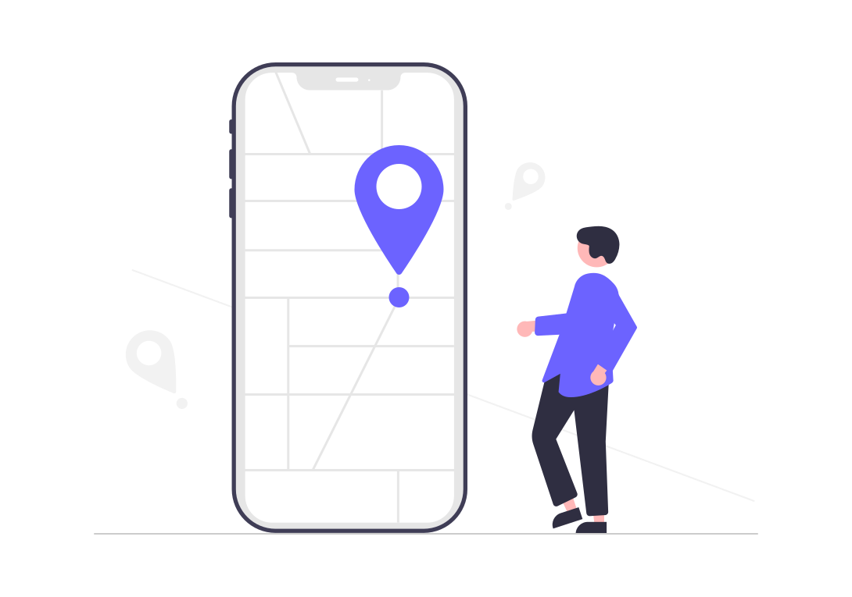
Research methodology
Choice of programming language
Method of data collection
This research work will be a mobile-based application where flutter will be employed in designing the front-end; SQLite will be used as the database, Django will be used as the backend, Django REST Framework as the web API, Google Maps API is used to interpret the set-out coordinates. The combination of the above will help build a very robust platform that will be useful, fast, and handy
Before developing any system, collecting data and facts about the existing system is critical to understand what is going on. This research was carried out using two methods.
Observation of the Work Environment
Interview
Documentation.

Slide 10
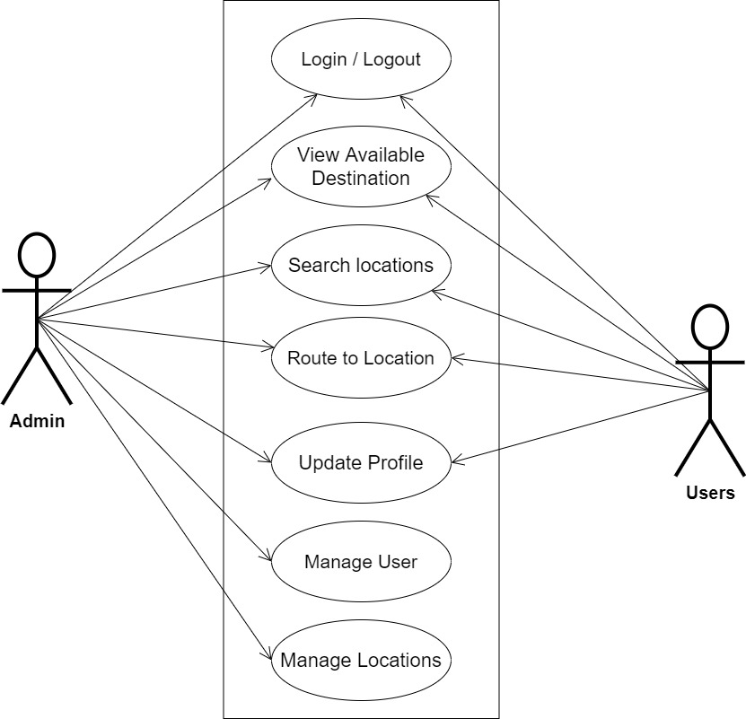
Human resources slide 7
SYSTEM MODELING (USE CASE DIAGRAM)

Slide 11
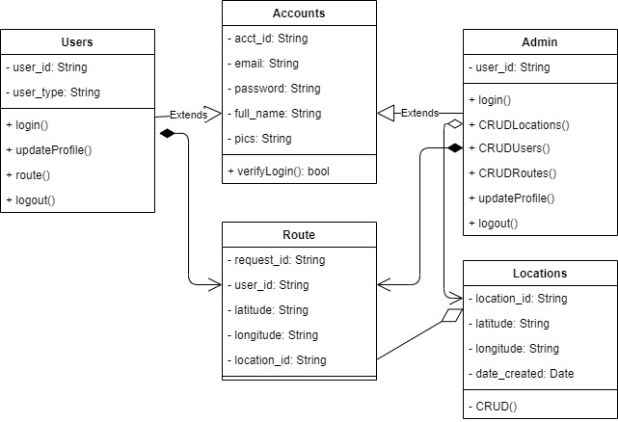
Human resources slide 7
SYSTEM MODELING (CLASS DIAGRAM)

Slide 12
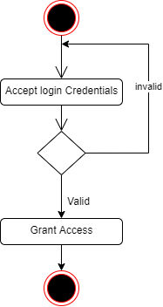
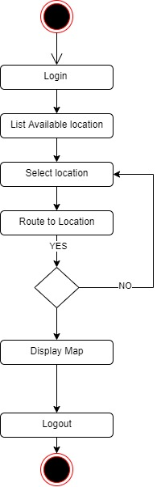
Human resources slide 7
SYSTEM MODELING (ACTIVITY DIAGRAM)
User Login Activity
Routing Activity

Slide 13
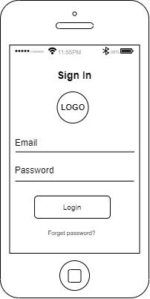
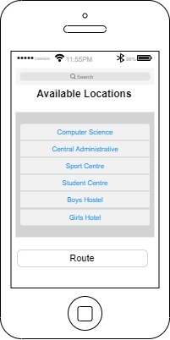
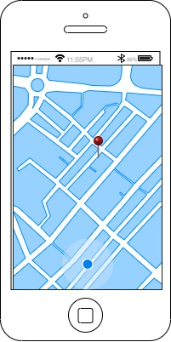
Human resources slide 7
PROPOSED INTERFACE DESIGN
User Login Screen
Available Location Screen
Routing Screen

Slide 14

Human resources slide 9
Summary
This research work is centered on providing navigational assistance for students on the main campus of Kaduna polytechnic, for effectiveness, it will provide assistance to a set of predefined locations on the main campus it will not cover providing navigation for students on other campuses.
In conclusion thee navigational assistance system could help improve student safety and satisfaction with the campus by providing them with the information and tools they need to find their way around.

Slide 15

Human resources slide 10
Thank You

